Slide 1
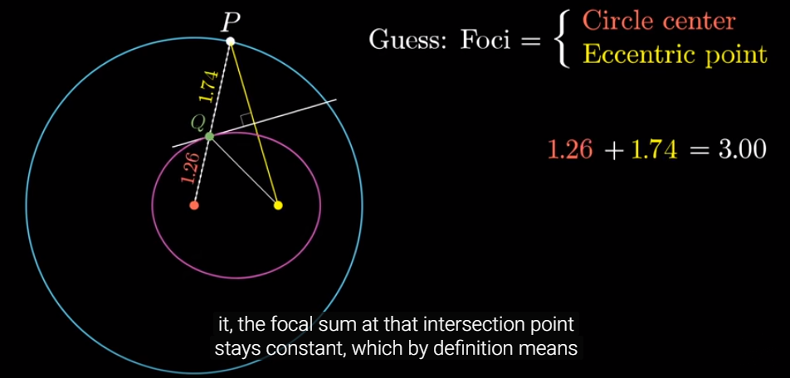

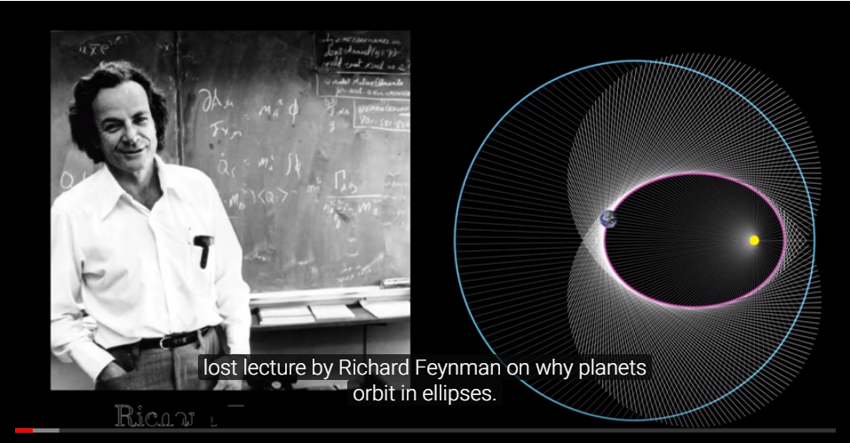
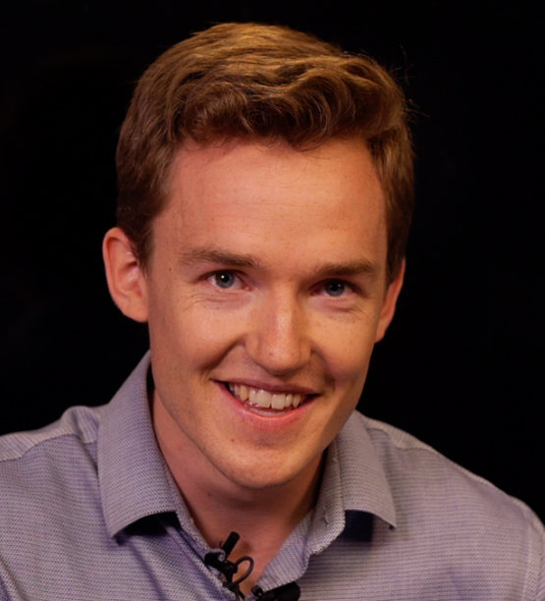
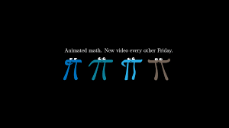
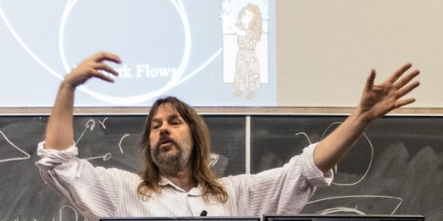
Orbit of Earth is an Ellipse
Lost lecture by Richard Feynman
Geometric explanation of why earths orbit in ellipses.
Images and learning from youtube:3blue1brown
https://www.youtube.com/watch?v=xdIjYBtnvZU
Grant Sanderson
of 3blue1brown
Jeff Edmonds
York University
Notes:
1

Slide 2
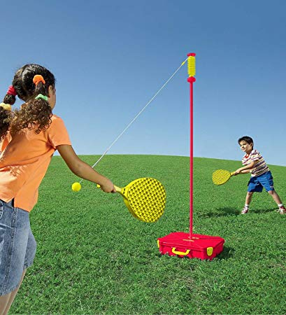
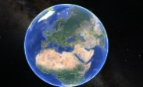


Orbit of Earth is an Ellipse
Of course earth the follows an ellipse around the sun!
  Like a tether ball.
The two dimensions resonate separately
$$\left\langle x,y \right\rangle =\left\langle a cos\left(θ\right),b\sin\left(θ\right)\right\rangle$$
Force of Gravity ∝ ¹/r²
➔ dimensions not separable.
Notes:
2

Slide 3


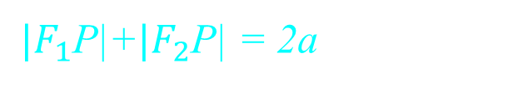
Orbit of Earth is an Ellipse
Of course earth the follows an ellipse around the sun!
Two pins and a string
feels simple and natural.
$|F_{1}$P|+$|F_{2}$P| = 2a
$$F_{2}$$
$$F_{1}$$
But what is at the
other focal point?
And why is the sum a constant?
Notes:
3

Slide 4



Orbit of Earth is an Ellipse
Of course earth the follows an ellipse around the sun!
A stretched circle
feels simple and natural.
$$y$$
${\left(\frac{x}{a}\right)}^{2}$+ ${\left(\frac{y}{b}\right)}^{2}$ = 1
$$x$$
A meaningless
coordinate system.
What would stretch things uniformly in this one direction?
Notes:
4

Slide 5
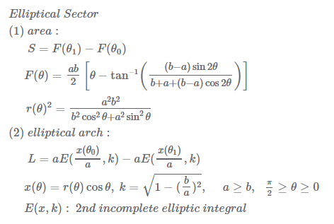



Orbit of Earth is an Ellipse
Of course earth the follows an ellipse around the sun!
Radial
feels simple and natural.
$$r$$
$$θ$$
Time:
Time($θ$)=
kind of ugly.
(Distance Traveled)
This is why we ignore time
and determine shape.
Notes:
5

Slide 6


Orbit of Earth is an Ellipse
Of course earth the follows an ellipse around the sun!
A straight fall
feels simple and natural.
$$r$$
Where r(t) is the earth
at time t?
https://www.wolframalpha.com
kind of ugly.
r(t) = 1.65 t^{2/3} works
Notes:
6

Slide 7
Orbit of Earth is an Ellipse
https://www.wolframalpha.com
Thanks I love your program.
r''(t)= -1/r^2 is the falling of a body into the sun. ei gravity is 1/r^2.
Your solution is very complicated. I don't understand it.
And it does not seem to contain my solution.
I found the solution r(t) = (9/2)^(1/3) t^(2/3).
See [(9/2)^(1/3) t^(2/3)]'', -[(9/2)^(1/3) t^(2/3)]^(-2).
In this solution, t is the time until collision.
At t=infinity time from collision, the body is infinity distance away
and has speed zero.
It takes infinite time to slowly accelerate.
As r gets close to zero, the acceleration goes to infinity,
so the speed goes to infinity.
At t=zero time from collision, the body is zero away
and has speed infinity.
Thanks so much Jeff
What do you think?

Slide 8
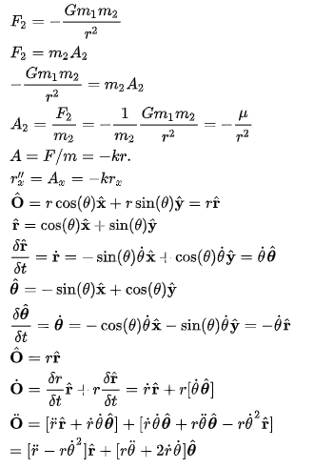
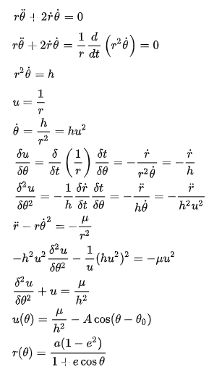
Orbit of Earth is an Ellipse
Of course earth the follows an ellipse around the sun!
Vector calculous is complicated.
kind of ugly.
Jeff rewrote the wiki page:
https://en.wikipedia.org/wiki/Orbit#Newtonian_analysis_of_orbital_motion
Notes:
8

Slide 9
Orbit of Earth is an Ellipse
Of course earth the follows an ellipse around the sun!
There are many little changes in physics whose effect would be that life as we know it could not happen.
(How did we get so privileged!)
The orbit could so easily be chaotic.
Notes:
9

Slide 10
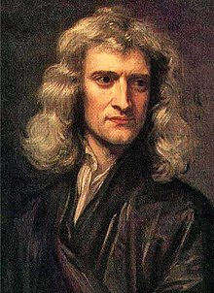
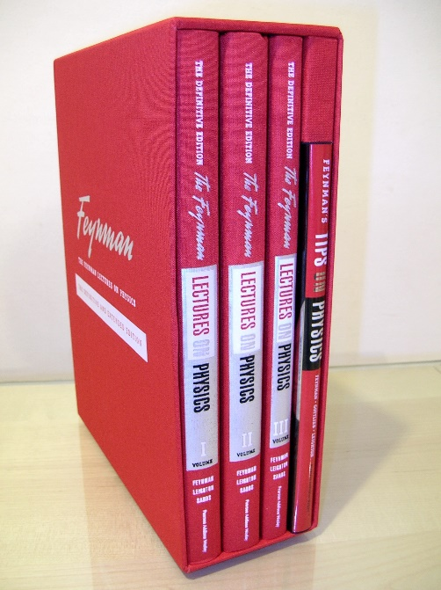
Orbit of Earth is an Ellipse
Of course earth the follows an ellipse around the sun!
Jeff read some of
Richard Feynman books
but it is not in there.
This was Newton’s proof?
Jeff heard they were
in the “lost lectures”
Notes:
10

Slide 11


Orbit of Earth is an Ellipse
Of course earth the follows an ellipse around the sun!
And the proof is geometrical!
And proves the sum to
the two focal points is constant!
This was Newton’s proof?
Fantastic!!!!
Notes:
11

Slide 12
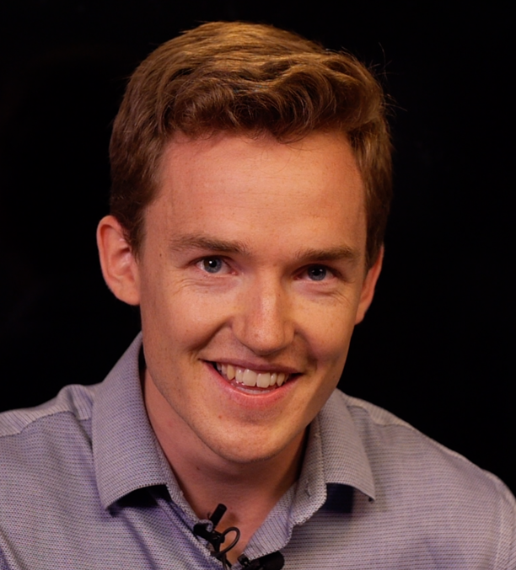
Orbit of Earth is an Ellipse
Of course earth the follows an ellipse around the sun!
Grant Sanderson
of 3blue1brown
made a fantastic video on it!
Which is where Jeff learned it.
https://www.youtube.com/watch?v=xdIjYBtnvZU
Notes:
12

Slide 13
Orbit of Earth is an Ellipse
Of course earth the follows an ellipse around the sun!
Why make ppt slides??
  when there is such a great video?
  And Jeff has no audience
  for this material?
Because Jeff has a ppt slide
making addiction.
I guess there are worse addictions.
He hopes someone enjoys them.
(Please let him know)
Which is where Jeff learned it.
Jeff Edmonds
York University
https://www.eecs.yorku.ca/~jeff/courses/
https://www.eecs.yorku.ca/~jeff/courses/fun/
Notes:
13

Slide 14
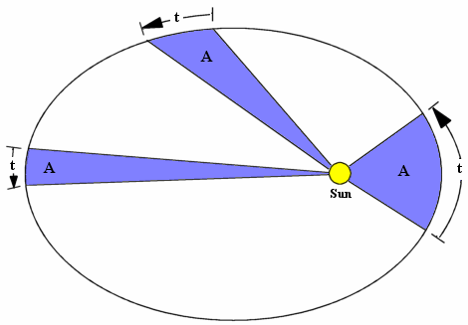
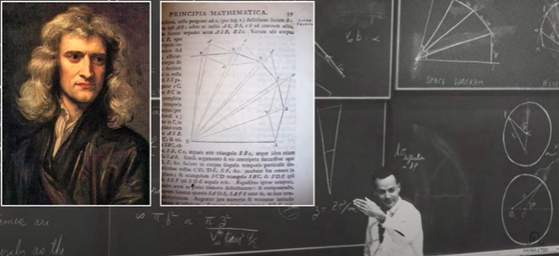
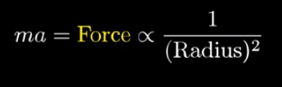
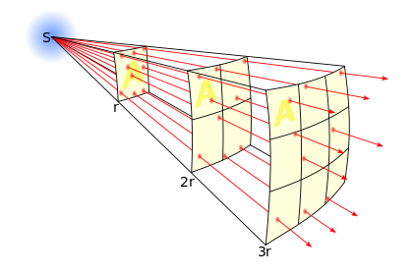
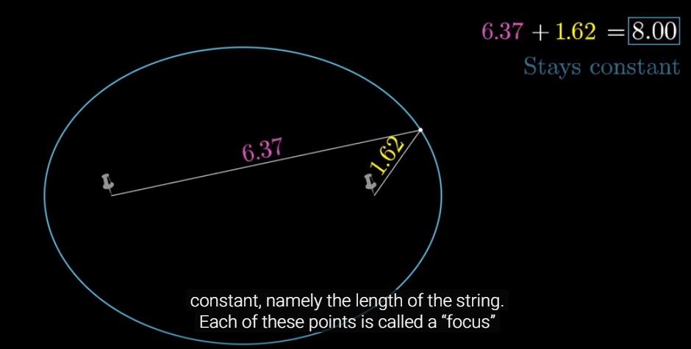
Orbit of Earth is an Ellipse
We will consider three facts:
Kepler’s second law:
In fixed time, same area traced out.
Newton’s Gravity:
Ellipse is formed by
              Observed by Kepler
              Proved by Newton.
              Geometrically reasonable
              Assumed by Newton.
              Proved mathematically.
Notes:
14

Slide 15
Orbit of Earth is an Ellipse
We will consider three facts:
Kepler’s second law:
In fixed time, same area traced out.
Newton’s Gravity:
Ellipse is formed by
              ➔ Path is ellipse
Notes:
15

Slide 16
Orbit of Earth is an Ellipse
We will consider three facts:
3. Ellipse is formed by
Notes:
16

Slide 17
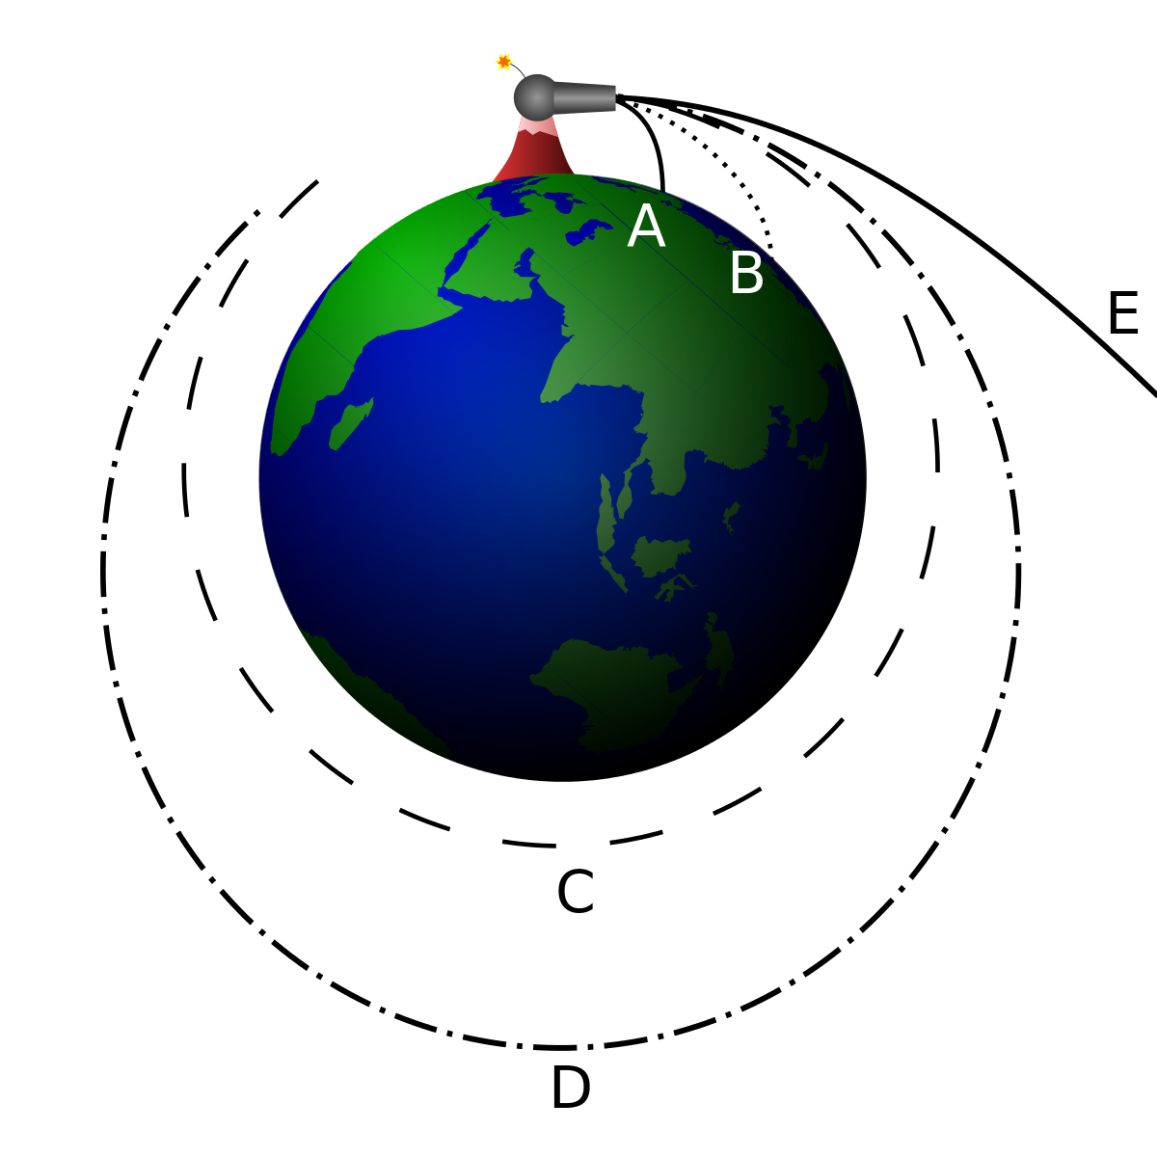
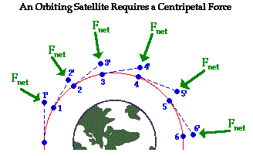
Orbit of Earth is an Ellipse
We will consider three facts:
Newton’s Gravity:
  Shoot a cannon:
  Its vertical falling and horizontal travelling are independent.
Near the earth, we assume that the rate of acceleration is a constant. 9.8 m/sec².
But further away, it decreases.
Notes:
17

Slide 18
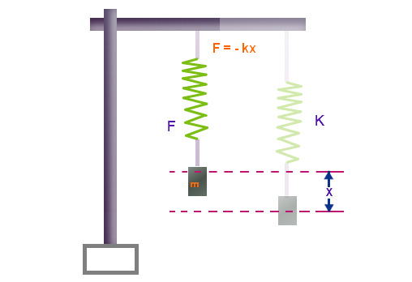
Orbit of Earth is an Ellipse
We will consider three facts:
Newton’s Gravity:
Force of a spring
as the distance increases
increase proportionally
∝ distances pulled
Intensity of light
as the distance increases
spreads out on area
area ∝ radius²
decreases proportionally
∝ ¹/r²
Force of gravity?
∝ ¹/r²
Notes:
18

Slide 19
Orbit of Earth is an Ellipse
We will consider three facts:
Newton’s Gravity:
  Acceleration of earth falling towards the sun
  is proportional to the force acting towards the sun
  is proportional to ¹/_{(distance to sun)}²
  a = ^{Δv}/_{Δtime} (change velocity / change in time)
  ∝ ¹/r²
kind of ugly.
https://www.wolframalpha.com
Notes:
19

Slide 20
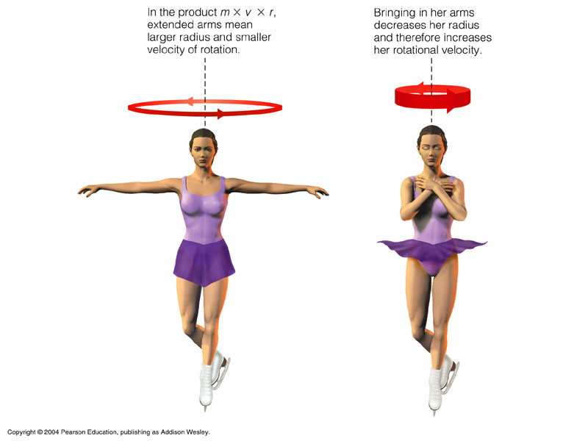
Orbit of Earth is an Ellipse
We will consider three facts:
Kepler’s second law:
In fixed time, same area traced out.
If close to sun must move fast.
If far must move slow.
  Observed by Kepler
  Now called conservation
  of angular momentum.
Notes:
20

Slide 21
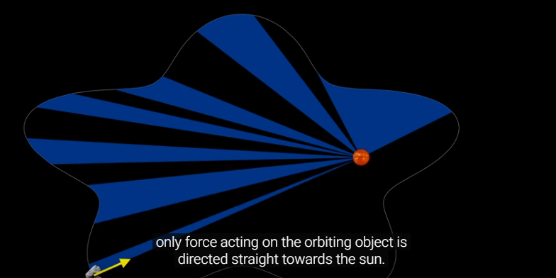
Orbit of Earth is an Ellipse
We will consider three facts:
Kepler’s second law:
In fixed time, same area traced out.
If close to sun must move fast.
If far must move slow.
  Observed by Kepler
  Now called conservation
  of angular momentum
  True as long as the only acting force is directed towards sun
  even if this force is strange.
Notes:
21

Slide 22
Orbit of Earth is an Ellipse
Notes:
22

Slide 23

In fixed time, same area traced out
Assume that force towards sun is not continuous
but comes in bursts ever dt time.
Hence, the path of the earth between these times
is a line.
| path of planet in first time interval.
| pulse of force at B towards S.
| path of planet in second time interval.
Result is:
Area triangle S| = Area triangle S|
C
B
A
C
B
S
S
A

Slide 24
In fixed time, same area traced out
| path of planet in first time interval.
| path in second interval had there been no force.
Note | = |.
| pulse of force at B towards S.
| path of planet in second time interval.
Note | = | + |.
c
C
B
A
S

Slide 25
In fixed time, same area traced out
Area triangle S| = Area triangle S|
because bases | & | are the same.
c
B
A
S

Slide 26
In fixed time, same area traced out
Area triangle S| = Area triangle S|
because base SB is the same.
and line Cc is parallel to this base SB.
c
C
B
S

Slide 27
In fixed time, same area traced out
Area triangle S| = Area triangle S|
Area triangle S| = Area triangle S|
Hence
Area triangle S| = Area triangle S|
Completing the proof.
c
C
B
A
S

Slide 28
Orbit of Earth is an Ellipse
We will consider three facts:
Kepler’s second law:
In fixed time, same area traced out.
  Δarea (change in area)
  ∝ (proportional to)
  Δtime (change in time)
  Δθ (change in angle)
  r (radius)
  Δx (change in location)
  = Δθ × r
  Δarea = ½ height × base
  ∝ ×
  ^{Δθ}/_{Δtime} = angular velocity
r
  Δθ × r
Δθ
  Δx =
Δθ × r
r
∝ ^{Δ θ} /_{Δarea}
∝ ¹/r²
kind of ugly.
=r
Notes:
28

Slide 29
Orbit of Earth is an Ellipse
We will consider three facts:
Kepler’s second law:
In fixed time, same area traced out.
  Δarea (change in area)
  ∝ (proportional to)
  Δtime (change in time)
  Δθ (change in angle)
  r (radius)
  Δx (change in location)
  = Δθ × r
  Δarea = ½ height × base
  ∝ ×
  ^{Δθ}/_{Δtime} = angular velocity
r
  Δθ × r
Δθ
  Δx =
Calculating kind area(θ) is ugly.
This is why we ignore time
and determine shape.
Δθ × r
r
∝ ^{Δ θ} /_{Δarea}
∝ ¹/r²
kind of ugly.
=r
Notes:
29

Slide 30
Orbit of Earth is an Ellipse
We will consider three facts:
Kepler’s second law:
^{Δθ}/_{Δtime} ∝ ¹/r²
Newton’s Gravity:
^{Δv}/_{Δtime} ∝ ¹/r²
    A constant = ¹/r² / ¹/r²
    ∝ Newton / Kepler
    = ^{Δv}/_{Δtime} × ^{Δtime}/_{Δθ}
    = ^{Δv}/_{Δθ}
    “^{Δv}/_{Δθ} = constant” will translate into lengths, angles, and shapes.
    Getting rid of time is good because it is
kind of ugly.
The r come from
different places.
kind of ugly.
But we can make them cancel.
kind of ugly.
Notes:
30

Slide 31
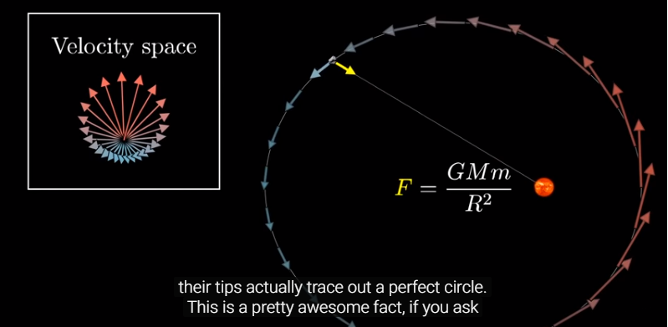
Orbit of Earth is an Ellipse
Set of Velocity vectors form a circle:
  = v = velocity vector of earth giving direction and speed.
  Take all such vectors occurring during orbit.
  Put all start of vectors together.
Notes:
31

Slide 32
Orbit of Earth is an Ellipse
Set of Velocity vectors form a circle:
  = v = velocity vector of earth giving direction and speed.
  Take all such vectors occurring during orbit.
  Put all start of vectors together.
  The endpoints form a circle.
Notes:
32

Slide 33
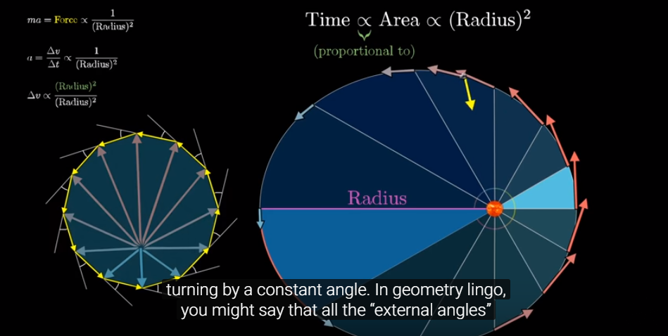
Orbit of Earth is an Ellipse
Set of Velocity vectors form a circle:
Divide orbit into equal angle Δθ segments
    ^{Δv}/_{Δθ} = Newton / Kepler
    = ^{Δv}/_{Δtime} × ^{Δtime}/_{Δθ} ∝ ¹/r² × r² = a constant
Δv = a constant
= v = velocity vector of earth when at this location.
= Δv = change in velocity vector.
= a = acceleration vector.
= is of constant length.
θ
Notes:
33

Slide 34
Orbit of Earth is an Ellipse
Set of Velocity vectors form a circle:
Divide orbit into equal angle Δθ segments
= v = velocity vector of earth when at this location.
= |Δv| = change in velocity
is always a fixed length.
= constant angle between consecutive Δv
is always pointing at sun
θ = angle around sun
Δθ = change in angle to sun.
= constant
Δθ
θ
Notes:
34

Slide 35
Orbit of Earth is an Ellipse
Set of Velocity vectors form a circle:
Divide orbit into equal angle Δθ segments
= v = velocity vector of earth when at this location.
= |Δv| = change in velocity
is always a fixed length.
= constant angle between consecutive Δv
forms a regular polygon
ie a circle
Δθ
θ
Notes:
35

Slide 36
Orbit of Earth is an Ellipse
Set of Velocity vectors form a circle:
Divide orbit into equal angle Δθ segments
= v = velocity vector of earth when at this location.
= |Δv| = change in velocity
is always a fixed length.
= constant angle between consecutive Δv
forms a regular polygon
The “center" of velocity vectors
is not at the center of this circle.
θ
Notes:
36

Slide 37
Orbit of Earth is an Ellipse
Some questions:
How do we define θ=0 and what is happening there?
If the “center" of velocity vectors
is not at the center of this circle,
then where is it?
Where is the sun and earth in this new velocity diagram?
How do we use this diagram to learn direction earth is traveling?
And to learn the path of orbit?
θ
Notes:
37

Slide 38
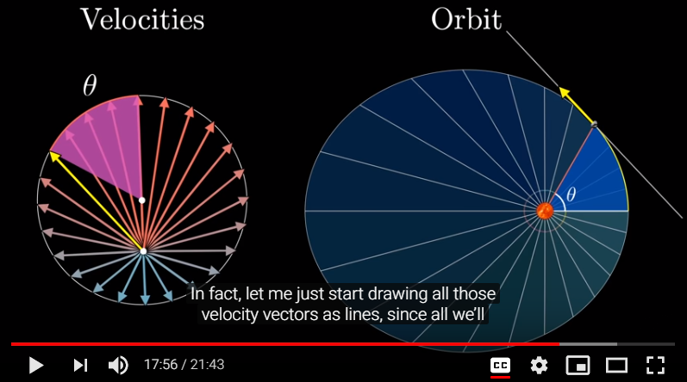
Orbit of Earth is an Ellipse
How do we define θ=0 and what is happening there?
Let us define θ=0 to be the angle where
The earth is closest to sun
And rotate the orbit diagram so that its on the right.
Here, the direction the earth is traveling must be
perpendicular to direction of sun.
Otherwise, a different point would be closest to sun.
θ
θ=0
θ=0
Notes:
38

Slide 39
Orbit of Earth is an Ellipse
How do we define θ=0 and what is happening there?
Let us define θ=0 to be the angle where
The earth is closest to sun
And rotate the orbit diagram so that its on the right.
The direction the earth is traveling must be
perpendicular to direction of sun.
➔Corresponds to fastest speed.
by Kepler’s rule.
θ
θ=0
θ=0
Notes:
39

Slide 40
Orbit of Earth is an Ellipse
Where is the “center" of velocity vectors?
θ
θ=0
θ=0
Notes:
40

Slide 41
Orbit of Earth is an Ellipse
What is at the “center" of velocity circle?
Recall that the orbit was divided into equal angle Δθ segments.
The earth travelling an angle θ around the sun
= corresponds to some number of those segment
= corresponds to the same number of in the velocity diagram.
= the angle around center of the velocity circle.
The sun must “be” at center of where this θ is measured.
θ
θ=0
θ
θ
Notes:
41

Slide 42
Orbit of Earth is an Ellipse
Determine the direction the earth is traveling, given its location:
Touching the circle here
is the corresponding velocity vector.
which gives the direction the earth is traveling.
θ
θ=0
θ
θ
Notes:
42

Slide 43
Orbit of Earth is an Ellipse
Prove path is an ellipse:
  By way of induction, assume that the earth
  followed the ellipse to its present location.
  We know how to determine the earth’s direction.
  Prove that this direction is in the direction of the ellipse here.
  Ignoring the speed (length) is fine.
Notes:
43

Slide 44
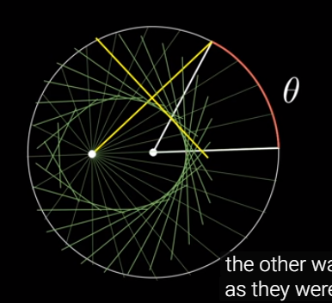
Orbit of Earth is an Ellipse
Prove that this direction is tangent to the ellipse:
  Ignoring the speed (length) is fine.
  In order to line up,
  rotate the velocity circle 90º clockwise
  Rotate the velocity line 90º back.
  so that it is again facing in the correct direction.
  Prove that this construction gives an ellipse.
Notes:
44

Slide 45
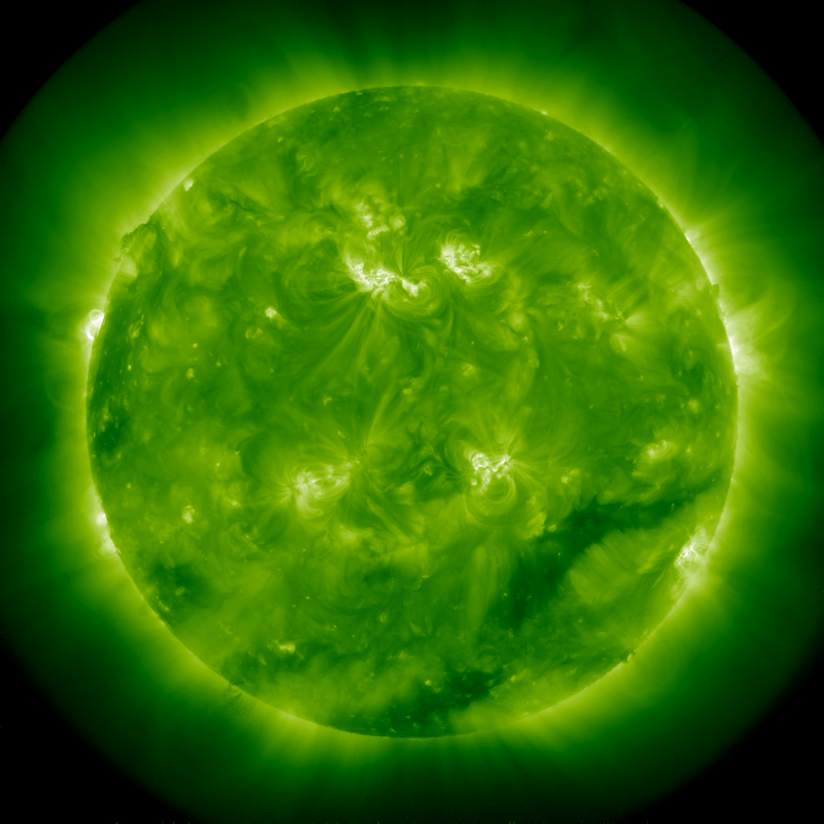
Orbit of Earth is an Ellipse
Prove this construction gives an ellipse:
  The sun’s location is:
  The sun’s “imaginary” location is
  The earth’s location is
  because we assumed it was
  on the ellipse so far
P
Notes:
45

Slide 46
Orbit of Earth is an Ellipse
Prove this construction gives an ellipse:
  Start with a circle and with center C.
  and some eccentric point E.
  Choose some point Q on the circle.
  Connect Q to both C and E.
  Draw the perpendicular bisector of EQ.
  Place P at the intersection
  of bisector and CQ.
  Put the earth there.
  PEQ is an equilateral triangle
  because it is perpendicularly
  bisected.
  |EP|=|PQ|
Prove P is on an Ellipse:
  |EP|+|CP|
  = |CP|+|PQ|
  = radius of circle = constant.
Q
P
E
C
Notes:
46

Slide 47
Orbit of Earth is an Ellipse
Prove that this direction is tangent to the ellipse:
  Because all points on this line
  have a bigger sum |EP’|+|P’Q|.
  And hence a bigger sum |EP’|+|CP’|.
  And hence are outside the ellipse.
Q
P’
E
C
  |EP|+|CP|
  = |CP|+|PQ|
  = radius of circle = constant.
Notes:
47

Slide 48
Orbit of Earth is an Ellipse
Prove that this direction is tangent to the ellipse:
  Hence, the direction given by the velocity vector
  ie tells the direction the earth is traveling
  is in the same direction that the ellipse is going.
Q
P
E
C
Notes:
48

Slide 49
Orbit of Earth is an Ellipse
But …. ?
I know that we put the rotated velocity vector put halfway between E and Q because it made the math work,
but if we put it somewhere else, then maybe we would
get a different shaped orbit.
Why is this one correct?
Q
P
E
C
Notes:
49

Slide 50
Orbit of Earth is an Ellipse
But …. ?
2. How do we determine the location of E relative to C?
Q
P
E
C
Notes:
50

Slide 51
Orbit of Earth is an Ellipse
But …. ?
This claims the Earth starts halfway from E to the circle.
How do we know it starts there?
Q
E
C
Notes:
51

Slide 52
Orbit of Earth is an Ellipse
But …. ?
This claim’s the velocity does not matter.
time does not matter.
how far the Earth travels in this direction does not matter.
But how do we know the Earth
does not overshoot the ellipse?
Q
E
C
Notes:
52

Slide 53
Orbit of Earth is an Ellipse
Some answers:
The input we start with is
the initial location of the Earth and its velocity
and the strength of the gravitational pull.
Notes:
53

Slide 54
Orbit of Earth is an Ellipse
Some answers:
We don’t care about change in time,
but what happens as the Earth moves
changing its angle by Δθ.
The length of the velocity vector
is how far the earth moves during this Δθ.
The length of the acceleration vector
is how much this velocity changes during this Δθ.
Δθ
Notes:
54

Slide 55
Orbit of Earth is an Ellipse
Some answers:
Together these define the entire circle of velocity vectors.
Along with the location of E and C.
θ
C
E
Notes:
55

Slide 56
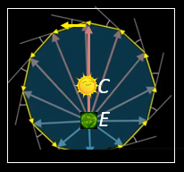
Orbit of Earth is an Ellipse
Some answers:
Because we only get angles from this picture,
it can be expanded.
6. Rotate and expand it so that the sun and the earth
are in the right places.
θ
C
Δθ
E
Notes:
56

Slide 57
Orbit of Earth is an Ellipse
Some answers:
Because we only get angles from this picture,
it can be expanded.
6. Rotate and expand it so that the sun and the earth
are in the right places.
Q
E
C
Notes:
57

Slide 58
Orbit of Earth is an Ellipse
Some answers:
Then from here the earth travels in the direction
tangent of the ellipse.
But not overshooting.
Because this lasts only for the duration of angle Δθ.
Q
Δθ
E
C
Notes:
58

Slide 59
Orbit of Earth is an Ellipse
Some answers:
6. From there it switches to the new direction for the ellipse.
7. In this way it follows the ellipse!
DONE!
Q
Δθ
E
C
Notes:
59

Slide 60
Orbit of Earth is an Ellipse
But …. ?
I know that we put the rotated velocity vector put halfway between E and Q because it made the math work,
but if we put it somewhere else, then maybe we would
get a different shaped orbit.
Why is this one correct?
Q
P
E
C
Notes:
60

Slide 61
Orbit of Earth is an Ellipse
Lost lecture by Richard Feynman
Geometric explanation of why earths orbit in ellipses.
Images and learning from youtube:3blue1brown
https://www.youtube.com/watch?v=xdIjYBtnvZU
Grant Sanderson
of 3blue1brown
Jeff Edmonds
York University
Notes:
61

Slide 62
End

Slide 63
Orbit of Earth is an Ellipse
Abstract: Orbit of earth is an Ellipse
Of course the follows an ellipse around the sun. But unlike a tether
ball, the dimensions not separable and the sun is not at the center
<x,y> = <a cos(θ), b sin(θ)>. The two pins and a string definition of
an ellipse feels simple and natural: |𝐹1 P| + |𝐹2 P| = 2a. But why is
the sum constant and what is at the other focal point. An ellipse
being a stretched circle feels simple and natural (x/a)^2 + (y/b)^2 =
1, but it is the wrong coordinate system. The correct one is radial
r(θ)=(a(1−e^2))/(1+e cos(θ)), but it is not simple. Vector calculous
is complicated. Presented is the beautiful geometric “lost” proof of
Richard Feynman as presented by Grant Sanderson of 3blue1brown.
Notes:
63

